Slide 1

Toronto Dine Safe Report

Slide 2

Agenda
Introduction
Dining Establishments Density
Restaurant Analysis
Establishment Status
Naughty List
Infraction Reasons and Severity
Conclusion

Slide 3
Introduction
Dine Safe is Toronto Public Health's food safety program that inspects all establishments serving and preparing food.
Each inspection results in a pass, a conditional pass or a closed notice.
With this report, we will try to analyse how safe are dining establishments such as bars, restaurants, bakery etc. in Toronto.
Dataset from the following link has been considered for this report:
https://www.toronto.ca/city-government/data-research-maps/open-data/open-data-catalogue/#e3c15b0f-5f83-0f12-fabb-c84018395c38

Slide 4
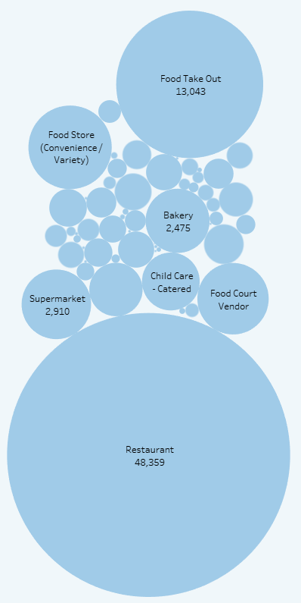
Dining Establishments Density
Toronto being the biggest Canadian business city, holds a huge number of dining options.
The number is as high as 48,359 for restaurants in the city.
Various other establishments also exist in the city with a great share such as Food Take Outs being 13,043, Supermarket 2,910, Bakery 2,475.
In the next section, we discover how well the restaurant industry is doing in Toronto.

Slide 5
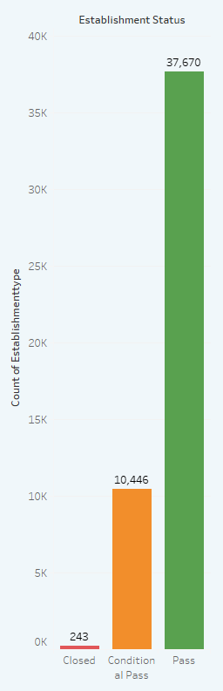
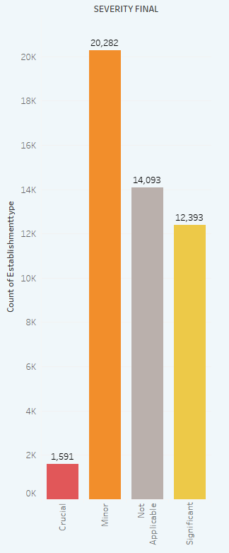
Restaurant Analysis
Over the last couple of years, about 45,000 restaurants errors occurred.
Of these, 243 restaurants were closed, 10,446 resulted in conditional pass status and 37,670 passed by an overwhelming majority.
Surprisingly 1591 restaurants committed crucial mistakes, nearly 12k significant mistakes and around 20k minor mistakes.
This means restaurants in Toronto are not completely safe for dining.

Slide 6
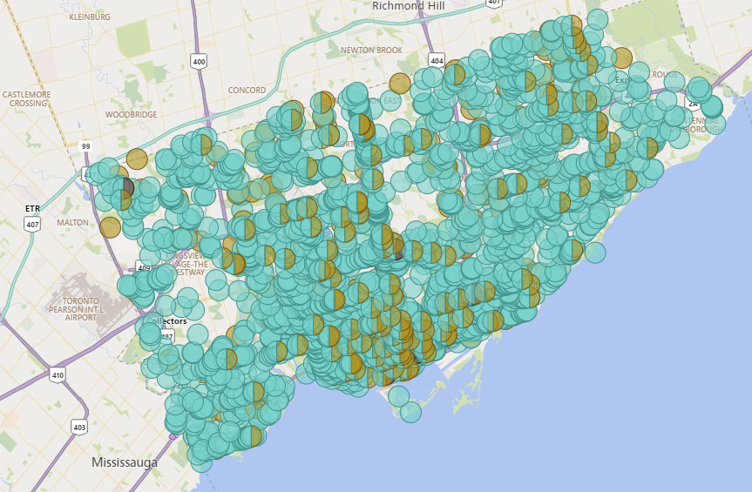
Establishment Status
For a collaborative supervisioning of the establishments, a map showing different outlets with their current status in the market has been plotted.
While the chart is dominated by pass status, but a great number conditional pass status foundations also exist.

Slide 7
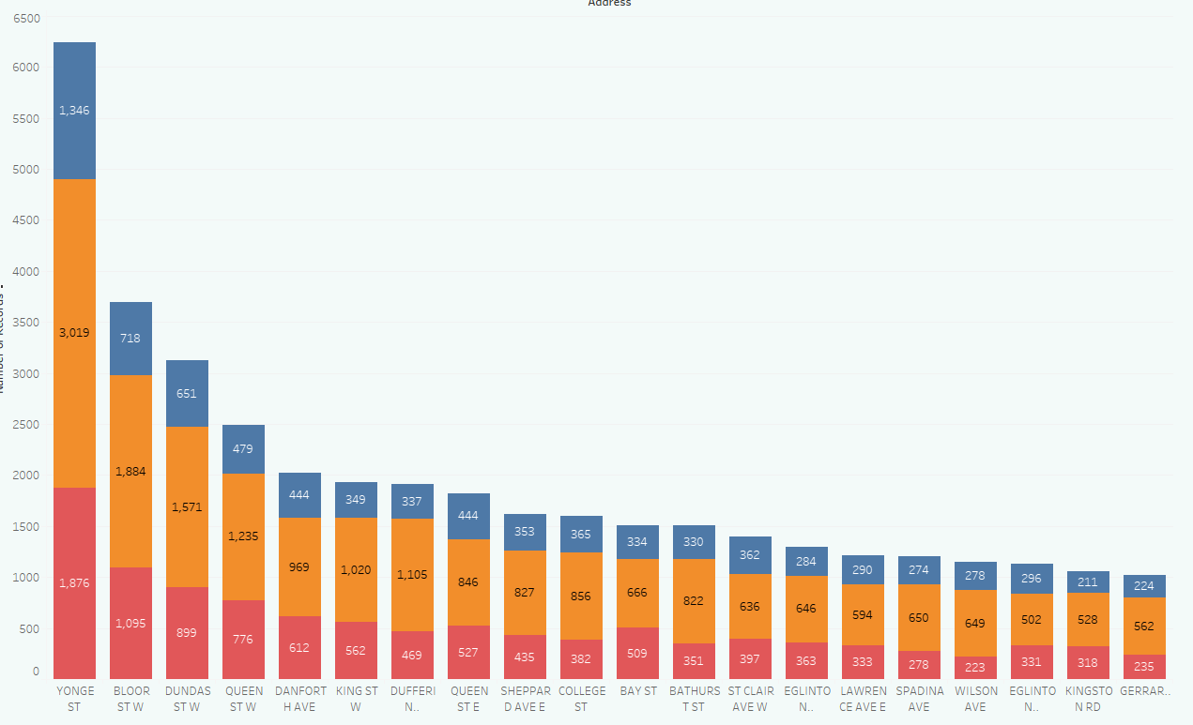
Naughty List
Chart describes top 20 streets for dining establishments.
Yonge Street, the longest street of Canada has the maximum number of defaulters.
More than 6K number of infractions were reported in the past years.

Slide 8
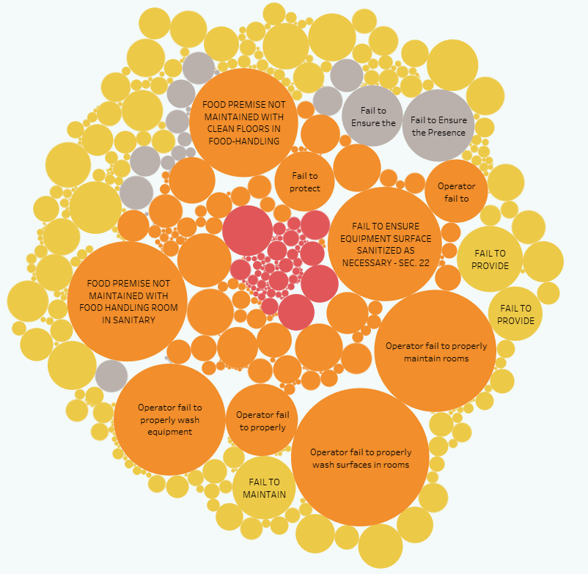
Infraction Reasons and Severity
With this chart, we reveal the errors committed by dining foundations.
A large number of significant severity faults have been observed in Toronto area.
One must be very careful in deciding the place of dining if ever decide to eat there.

Slide 9
Conclusion
To conclude this report, we discovered that dining establishments in Toronto are very much flawed.
Errors committed by restaurants are high in number.
The place of dining must be decided very carefully after observing its history.
We are thankful to Dinesafe for providing the dataset publicly and hence notable deductions were made.

